Slide 1
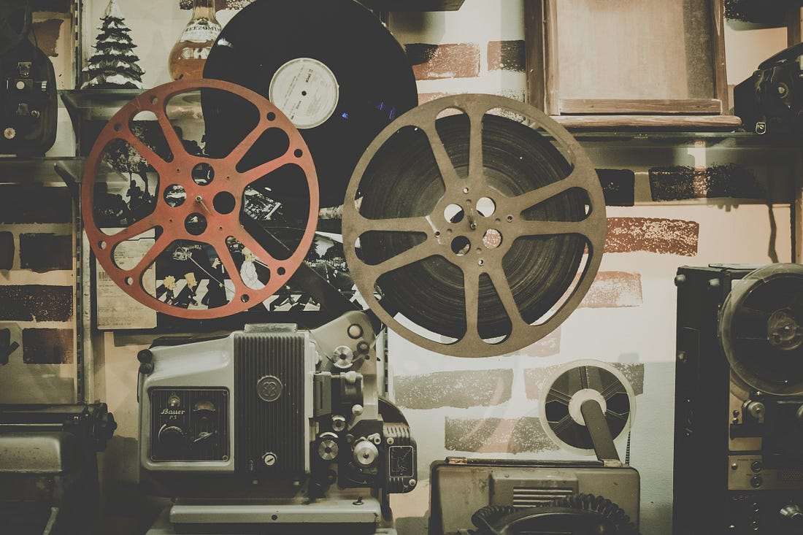
WELCOME

Slide 2


THYVIEW MOVIE RECOMMENDATION SYSTEM
Under the Guidance of
B. Vani Madam

Slide 3


TEAM MEMBERS
B. RAJU(602520539004)
CH. MANISH(602520539005)
D. PRAVEEN(602520539006)
D.BHAGAVAN(602520539007)
P. ANJALI(602520539019)

Slide 4
ABSTRACT
Ever wondered how Netflix or Hotstar recommends new movies based on the watch history, how Amazon or Flipkart suggests new products based on your order or search history?
These suggestions or recommendations are done by a system called a recommendation system.
This engine makes suggestions by learning and understanding the patterns in your watch history and then applies those patterns and findings to make new suggestions.
In this machine learning project, we build a recommendation system from the ground up to suggest movies to the user based on his/her preferences.

Slide 5
CONTINUOUS………
There are several datasets available to build a movie recommendation system.
But for this project, we are going to use a dataset that contains the metadata (cast, crew, budget, etc..) of the movie.
Recommendation systems are computer programs that suggest recommendations to users depending on a variety of criteria.
These systems estimate the most likely product that consumers will buy and that they will be interested in

Slide 6
SYSTEM REQUIREMENTS
Hardware Requirements
A PC with Windows/Linux OS
Processor with 1.7-2.4gHz speed
Minimum of 8gb RAM
2gb Graphic card
Software Specification
Text Editor (VS-code/WebStorm)
Anaconda distribution package (PyCharm Editor)
Python libraries

Slide 7
INTRODUCTION
A recommendation system is an artificial intelligence or AI algorithm, usually associated with Machine Learning, that uses Big Data to suggest or recommend additional products to consumers.
Recommender systems handle the problem of information overload that users normally encounter by providing them with personalized, exclusive content and service recommendations.
Recently, various approaches for building recommendation systems have been developed, which can utilize either collaborative filtering, content-based filtering or hybrid filtering.

Slide 8
OBJECTIVE OF THE PROJECT
Improving the Accuracy, Quality, Scalability, enhancing the user experience.
To eradicate the overload of the data, recommendation system is used as information filtering tool in social networking sites.
Movie Recommendation system is very powerful and important system. But, due to the problems associated with pure Content approach, movie recommendation systems also suffers with poor recommendation quality and scalability issues.

Slide 9
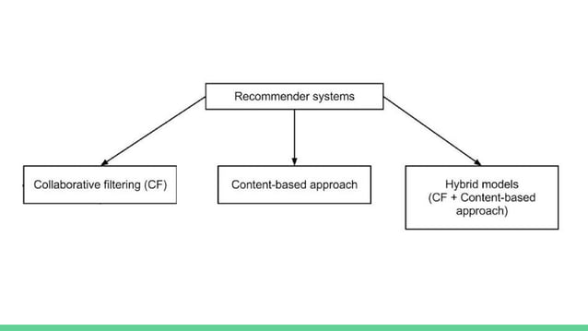

Slide 10
CONTENT BASED FILTERING
It uses only the item data maintaining a profile for each item. Each user is assumed to operate independently. No need for data on other users.
Considering the attributes or feature of the item, it finds the similarity between items, and recommends the most similar item for an item.
If we consider the content of a movie as director, writer, cast etc., then each of these attribute can be considered as a feature.

Slide 11
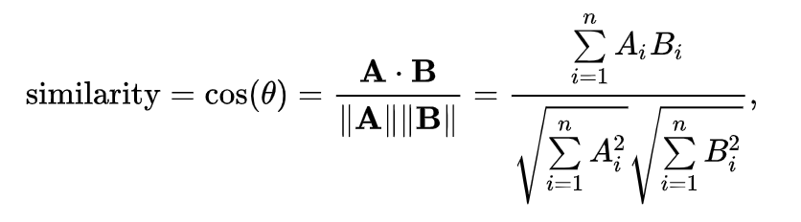
DISTANCE MEASURE
Cosine similarity is a method for measuring similarity between vectors. Mathematically, it calculates the cosine of the angle between the two vectors. If the angle between the two vectors is zero, the similarity is calculated as 1 because the cosine of zero is 1. So the two vectors are identical. The cosine of any angle varies from 0 to 1. Therefore, similarity rates will vary from 0 to 1. The formula is expressed as follows:

Slide 12
DISADVANTAGES
Cannot filter items on some assessment of quality, style or viewpoint because of lack of consideration of other people's experience.
Absence of personal recommendations.
No serendipitous items i.e. the ability of the system to give an item surprisingly interesting to a user, but not expected or possibly foreseen by the user.

Slide 13
METHODOLOGY
We need to perform preprocessing on the dataset and combine the relevant features into a single feature.
Later, we need to convert the text from that particular feature into vectors.
Later, we need to find the similarity between the vectors.
Finally, get the recommendations as per the system architecture mentioned below.
1). Collection of Data Sets: Collecting all required data sets from Kaggle website. In this project we required a tmdb 5000 movie dataset.

Slide 14
CONTINUOUS…….
2). Data Analysis: Make sure that the collected data sets are correct and analyzing the data in the csv files. i.e. checking whether all the column Fields are present in the data sets.
3). Algorithm: In our project we have use cosine similarity and CountVectorizer.
4). Training and Testing the model: once the implementation of algorithm is completed . we have to train the model to get the result. We have tested it several times the model is recommend different set of movies to different users
5). Improvement in this project: In the later stage we can implement different algorithms and methods for better recommendation.

Slide 15
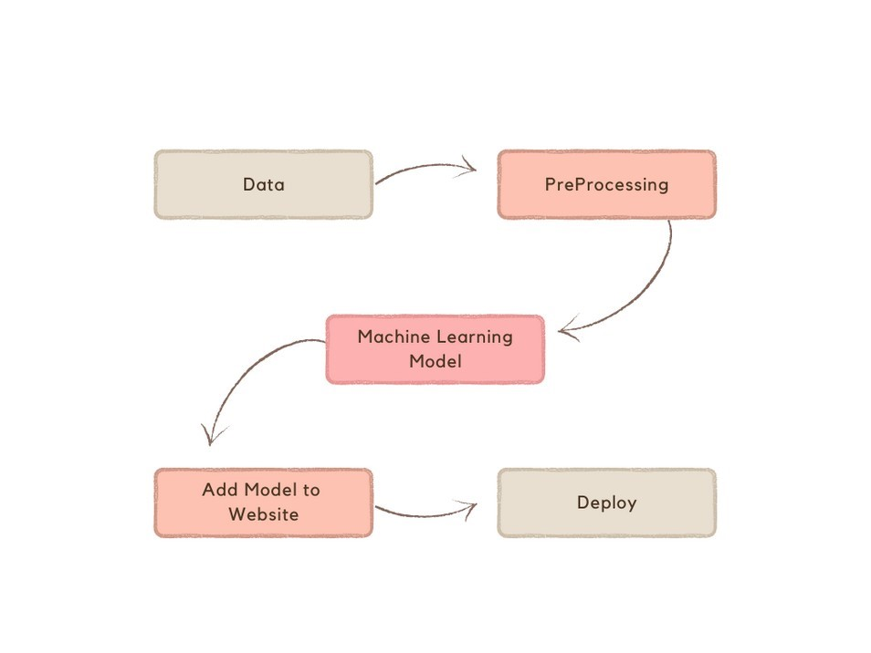
PROGRAM FLOW

Slide 16
PROGRAM FLOW
Initially load the data sets that are required to build a model.
The data set that are required in this project are tmdb_5000_credits.csv and tmdb_5000_movies.csv all the data sets are available in Kaggle.com.
Basically, three models are created using a content-based approach and then imported into a website using the Streamlit Python library used for creating web apps.
And at last deploy that website to the heroku server.

Slide 17
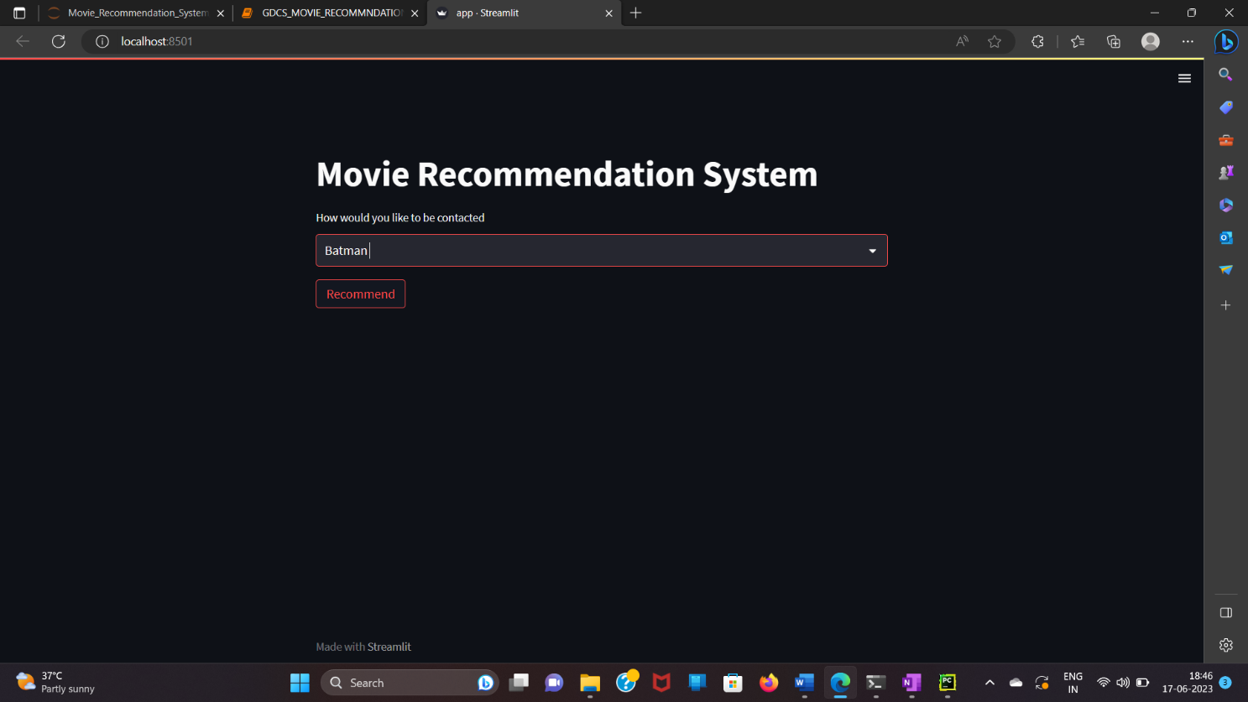
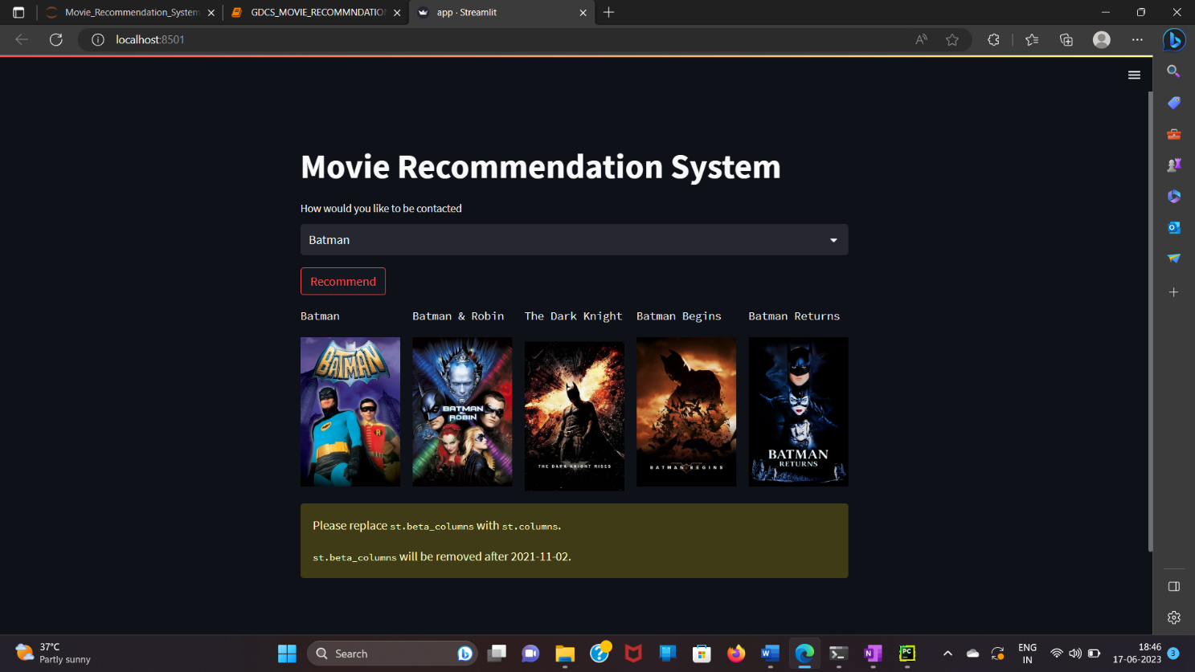
PROGRAM SCREENS

Slide 18
RESULTS AND ANAYLSIS
Recommendation Systems have become an important part of everyone’s life.
With the enormous number of movies releasing every year people often miss out on amazing work due to lack of correct Suggestions.
Putting Machine learning based Recommendation Systems into work is thus is very important to get the right Recommendations.
Since our project is movie recommendation system .one can develop a movie recommendation system by using either content based

Slide 19
CONTINUOUS
In our project we have developed a Content-Based approach.
Content-based filtering uses item features to recommend other items similar to what the user likes, based on their previous actions or explicit feedback.
The model should recommend items relevant to this user. To do so, you must first pick a similarity metric (for example, Cosine distance).
Then, you must set up the system to score each candidate item according to this similarity metric. Note that the recommendations are specific to this user, as the model did not use any information about other users.

Slide 20
FUTURE SCOPE
In the proposed approach, It has considered Genres of movies but, in future we can also consider age of user as according to the age movie preferences also changes, like for example, during our childhood we like animated movies more as compared to other movies.
There is a need to work on the memory requirements of the proposed approach in the future.
The proposed approach has been implemented here on different movie datasets only.
It can also be implemented on the Film Affinity and Netflix datasets and the performance can be computed in the future.

Slide 21
REFERENCE
Ahmed, Muyeed, Mir Tahsin Imtiaz, and Raiyan Khan. "Movie recommendation system using clustering and pattern recognition network." 2018 IEEE 8th Annual Computing and Communication Workshop and Conference (CCWC). IEEE, 2018.
Arora, Gaurav, et al. "Movie recommendation system based on users’ similarity." International Journal of Computer Science and Mobile Computing 3.4 (2014): 765-770.
Aggarwal C.C. Recommender Systems. Springer; Berlin/Heidelberg, Germany: 2016. An Introduction to Recommender Systems; pp. 1–28.
Full Code: GitHub - campusx-official/movie-recommender-system-tmdb-dataset: A content based movie recommender system using cosine similarity.

Slide 22


